Slide 1

Jiangsu Henglihong Technology Co., Ltd.
product presentation

Slide 2






content
01
02
03
04
05
company profile
product presentation
technological superiority
application case
service commitment

Slide 3

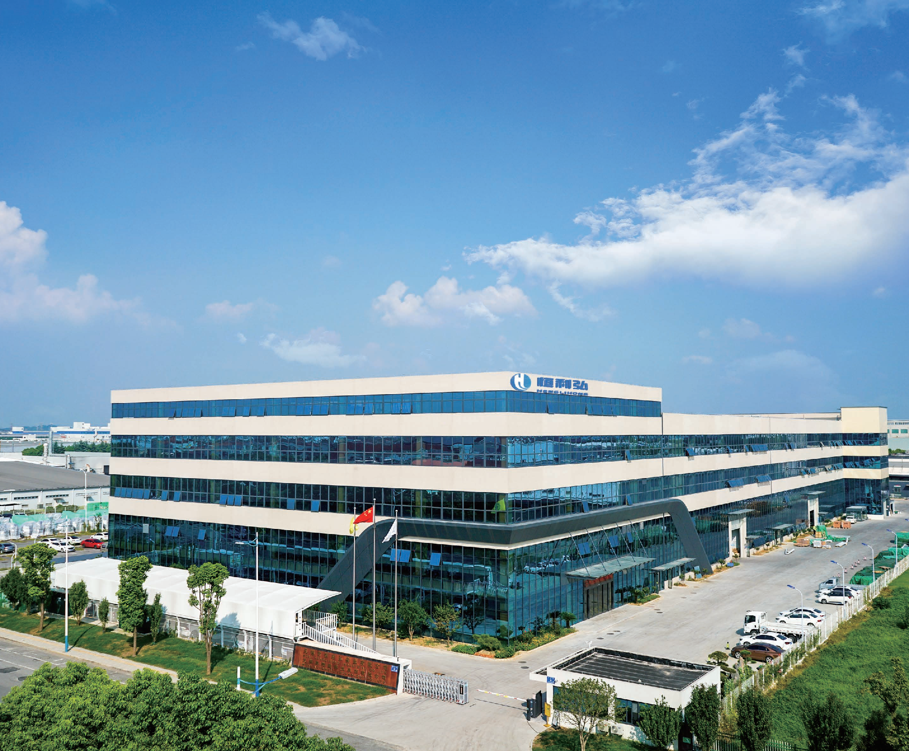
1.company profile
Jiangsu Henglihong Technology Co., Ltd.
n
n
n
Jiangsu Henglihong Technology Co., Ltd. was founded in 2005 and has been dedicated to surface treatment technology.
New material technology research and production application sales.
The company currently offers three series of cutting blades: HD 25, HS 25, and E25, designed for semi
The team specializes in processing conductor wafers, packaging substrates, and various hard and brittle materials including LTCC, PZT, and TGG. They have mastered core technologies such as precision electroplating, abrasive particle size control, and precision machining, with their blade production capabilities ranking among the top in China.
Team Profile: Core members specialize in cutting, grinding, and polishing tool research at multinational corporations and state-owned enterprises.
With over 20 years of experience, we have served more than 300 clients, accumulating extensive expertise in product development and field applications.

Slide 4
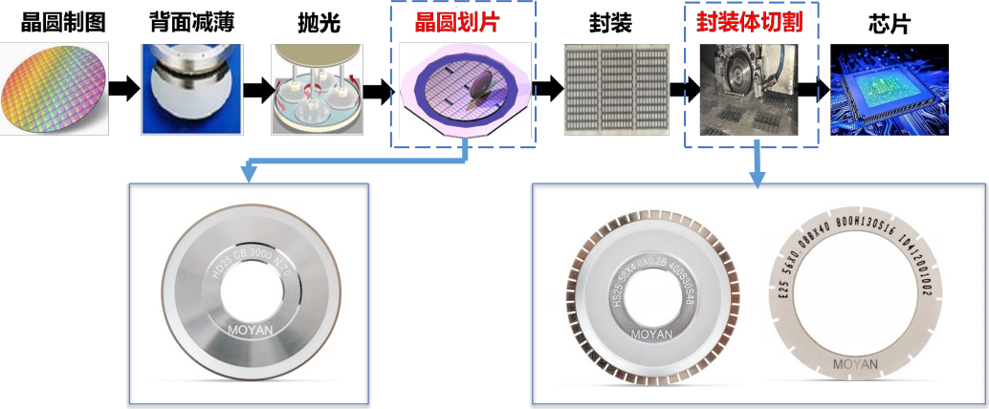
1.company profile
Product application areas
nThe HD25, HS25, and E25 series of cutting blades are widely used in wafer dicing (pre-packaging) and package singulation (post-packaging), covering semiconductor manufacturing processes.
Conductor wafers, packaging substrates, and various hard and brittle materials such as LTCC, PZT, and TGG.
Beta testing process
HD25 series wafer dicing blades (HS25 and E25) and packaging dicing blades

Slide 5
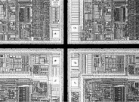
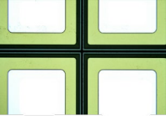
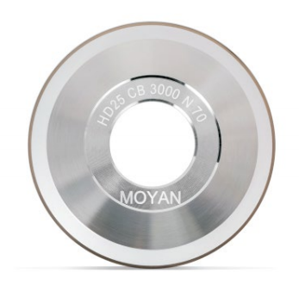
2.product presentation
HD25 series:
HD25 series hard tools are characterized by high-precision machining and narrow cutting margins, making them suitable for...
Silicon wafers, oxide wafers and various compound wafers such as silicon carbide, gallium arsenide, gallium phosphide.
Specification example: H D 25 CB 30 00N 7 0
Exposure of blade edge, width of cut, particle size, binder, concentration
Z 250-380 Z 11-15 5000 2 500 S Sharp Type 50
A | 380-510 | A | 16-20 | 4800 | 2000 | N | general type | 70
B | 510-640 | B | 20-25 | 4500 | 1800 | H | high strength type | 90
C 640-760 C 25-30 4000 1700 110
D 760-890 D 30-35 35 00 1500 130
E 890-1020 E 35-40 3000 1000 Volume concentration
F 1020-1150 F 40-50 mesh
G 1150-1270 G 50-60
(μm) (μm)

Slide 6

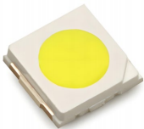
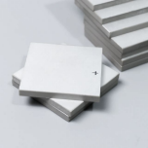
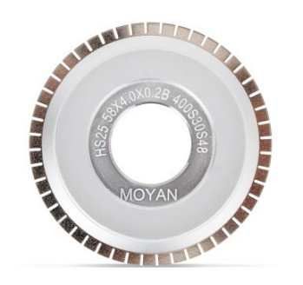
2.product presentation
HS25 series:
The HS25 series hard knives feature excellent wear resistance and superior blade stability, effectively controlling the side of chip particles.
The step surface ensures particle size consistency, making it suitable for ceramic LED substrates, semiconductor packaging substrates, and hard brittle materials such as PZT and TGG.
Example specification: HS25 58 × 4.0 × 0.2B 400S30S48
Outer diameter Exposed amount Thickness Thickness tolerance Particle size Binder Concentration Number of slots
56 2.0 3.4 0.06 0.20 A ±0.005 1200 S Sharp type 30 S16 16
58 2.2 3.6 0.08 0.22 B ±0.010 1000 N Universal Type 50 S32 32
(mm) 2.4 3.8 0.10 0.24 C ±0.015 800 H High-strength type 70 S48 482.6 4.0 0.12 0.26 (mm) 600 90
2.8 | 4.2 | 0.14 | 0.28 | 500 | 110
3.0 | 4.4 | 0.16 | 0.30 | 400 | 130
3.2 | 4.6 | 0.18 | 0.32 | 340 | 150
0/+0.2 (mm) (mm) Mesh size Volume concentration

Slide 7
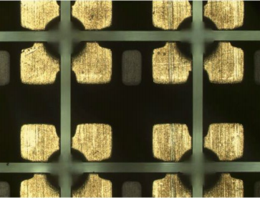
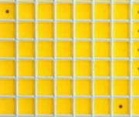
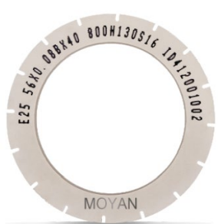
2.product presentation
ES25 series:
The ES25 series soft knives feature a cutting speed of up to 200mm/s and a service life exceeding 7000m, making them ideal for...
It is used in PCB substrates, EMC substrates, Chip LED substrates, and hard brittle materials such as LTCC, PZT, and TGG.
Spec example: E25 56 × 0.08B × 4 0 800H130S16
Outer diameter Thickness Thickness tolerance Inner diameter Particle size Binder Concentration Number of slots
50 0.02 0.16 P ±0.003 40 1200 Sharp type 30 S16 16
52 54 | 0.04 0.18 0.06 0.20 | A ±0.005 (mm) B ±0.010 | 1000 800 | N: General type H: High-strength type | 50 70 | S32 32
 |  |  |  |  |  | S48 48
56 0.08 0.22 C ±0.015 600 90
58 0.10 0.24
(mm)
500
400
110
130
59 0.12 0.26
(mm) 0.14 0.28 340 150
(mmm) Mesh size Volume concentration

Slide 8
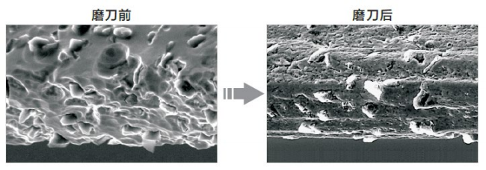
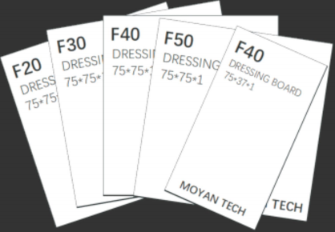
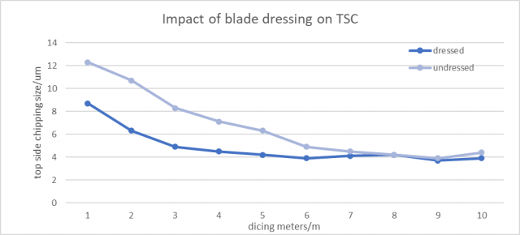
2.product presentation
Blade series:
Shape and sharpen various blades. Eliminate quickly.
The blade is installed eccentrically, and the cutting edge is fully exposed, which shortens the pre-cutting time and makes the blade enter the good cutting state quickly.
Sharpening can improve the initial positive collapse

Slide 9


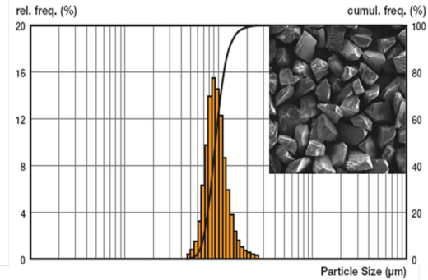
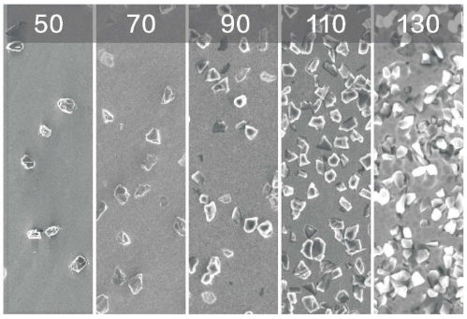
3.technological superiority
Advantage 1:
Advantage 2:
The ultra narrow size distribution of diamond powder and the super high volume fraction of crystal form selection ensure the excellent processing quality.
The systematic and precise diamond concentration grading control ensures optimal processing quality (particularly back breakage) while extending tool life.

Slide 10
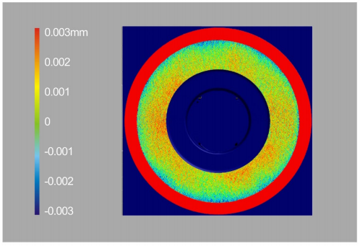
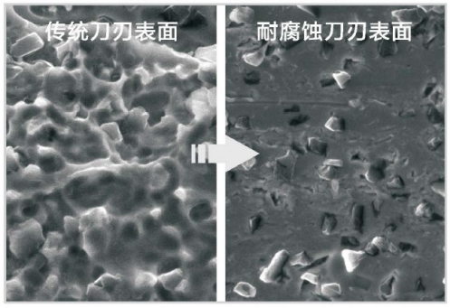
3.technological superiority
Advantage 3:
Advantage 4:
The high precision of wheel hub and blade manufacturing reduces pre-cutting time and blade vibration at high speed.
The blade boasts exceptional corrosion resistance, making it ideal for CO2 cutting environments and significantly extending its service life.

Slide 11
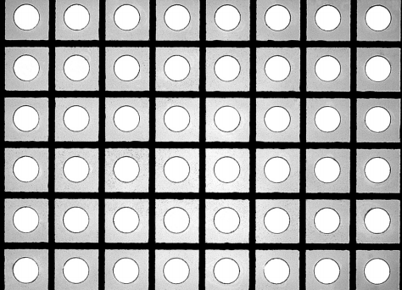
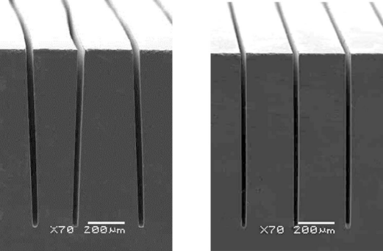
3.technological superiority
Advantage 5:
Advantage 6:
The cutting edge width is ultra-narrow, with a minimum of 10μm, meeting the requirements for narrow-belt wafer cutting in gallium arsenide LEDs and similar applications.
The blade exhibits exceptional strength, preventing zigzagging during high-speed operation while maintaining the chips side perpendicularity.

Slide 12
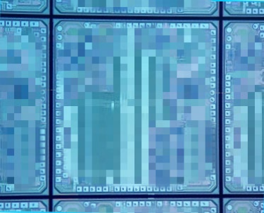


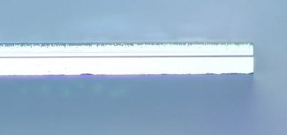
4.application case
HD 25 Series Wafer Cutter Case Study-High-end Integrated Circuit Wafer Cutter Case Study
front
the back
side
Blade specifications: Z1: HD25 BB 3500N70, Z2: HD25 AA 4000N50
Wafer type: | 12-inch IC silicon wafer | Wafer thickness: | 120um
Z1 axis speed: | 45000rpm | Z1 axis feed rate: | 45mm/s
Z2 axis speed: | 35000rpm | Z2 axis feed rate: | 45mm/s

Slide 13
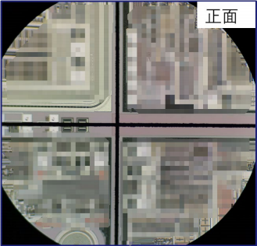
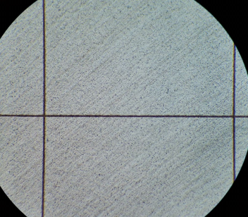
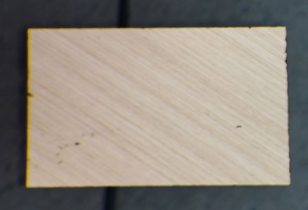
4.application case
Case of HD25 series wafer dicing
-No laser ablation, cutting path containing metal
the back
Single chip backside
Blade specifications: Z1: HD25 CC 4000N70, Z2: HD25 CB 3500N50
Wafer type: | 8-inch IC silicon wafer with metal-containing cutting paths, laser ablation-free | Crystal diameter thickness: | 220um
Z1 axis speed: | 55000rpm | Z1 axis feed rate: | 60mm/s
Z2 axis speed: | 35000rpm | Z2 axis feed rate: | 60mm/s

Slide 14

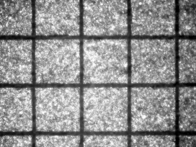
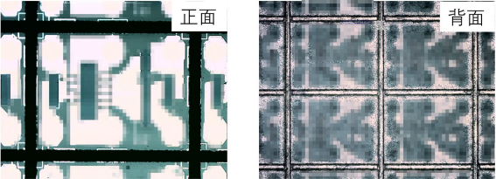
4.application case
Case of HD25 series wafer dicing
-Cutting conditions for the smallest die
-Oxide wafer dicing case
front
the back
Blade specifications: HD25 AA 50 00H90
Wafer type: | gallium arsenide, LED | Wafer thickness: | 150um
chip size ： | 98umx98um | Incision width: | ≤20um
feed velocity ： | 20-50mm/s | main shaft speed ： | 40krpm
Blade specifications: HD25 DD 2000S50
Wafer type: | lithium tannate, filter | Wafer thickness: | 200μm
chip size ： | 1.2 × 0.8mm | Block width: | 80um
feed velocity ： | 15-25mm/s | main shaft speed ： | 40krpm

Slide 15
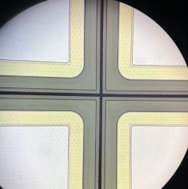
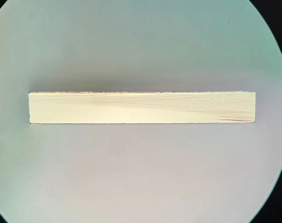
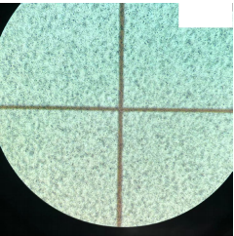
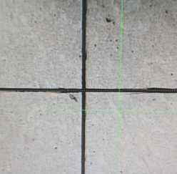
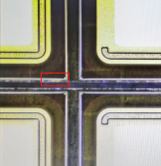
4.application case
Case of HD25 series wafer cutting
Cutting of SiC chips
front
side
the back
the back
Blade specifications: HD25 BB 2000N50 and HD25 BE 2000N50
Wafer type: | SiC, 6 inch, gold back | Wafer thickness: | 180-380um
chip size ： | 4.5x4.5 mm | Incision width: | 60um
feed velocity ： | 5-6mm/s | main shaft speed ： | 45-55K rpm
nSharpening process The mid-cutting process can greatly improve The crack shown in the right image has a stable crack of 20 μm. below 。

Slide 16
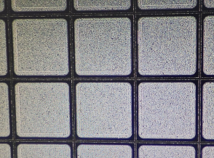
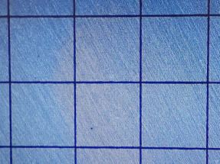
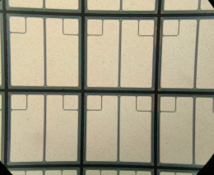

4.application case
Case of HD25 series wafer dicing
-Schottky chip dicing case
-MOSFET Chip Dicing Case
front
the back
front
the back
Blade specifications: HD25 BA 4000N7 0
Wafer type: | Silicon, 6 inches, silver back | Wafer thickness: | 150μm
chip size ： | 0.94 × 0.94mm | Block width: | 50-100um
feed velocity ： | 60mm/s | main shaft speed ： | 35krpm
Blade specifications: HD25 BB 4 000N50
Wafer type: | silicon wafer MOS transistor | Wafer thickness: | 150μm
chip size ： | 0.6 × 0.6mm | Block width: | 60um
feed velocity ： | 40-60mm/s | main shaft speed ： | 35krpm

Slide 17
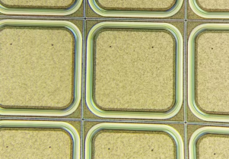
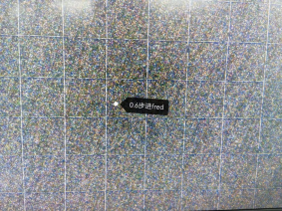
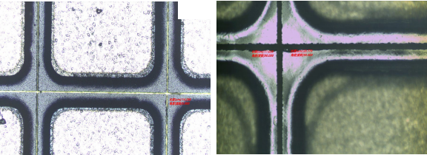
4.application case
Case of HD25 series wafer dicing
-FRED chip cutting case
GPP Chip Cutting Case
front
the back
Front Back
Blade specifications: HD25 BA 3500H 70
Wafer type: | Silicon, 5 inches, silver back | Wafer thickness: | 275μm
chip size ： | 0.56 × 0.56mm | Block width: | 55um
feed velocity ： | 40mm/s | main shaft speed ： | 38krpm
Quality requirements: Front break <10um, back break <30um, seam width <22um
Blade specifications: HD25 CB 2000N110
Workpiece material: | GPP:Si + Glass | application area ： | power device
Wafer size: | 4 inch | Wafer thickness: | 360um
feed velocity ： | 11mm/s | main shaft speed ： | 40k rpm
Quality requirements: Front break <10um, back break <20um, seam width <25um

Slide 18
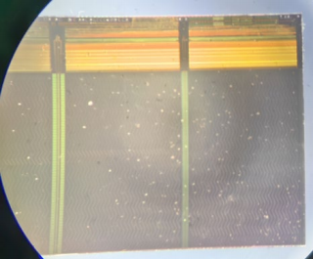
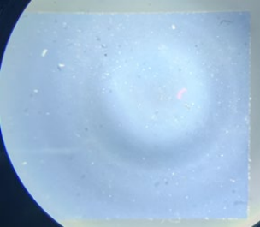
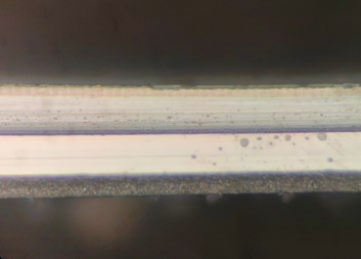

4.application case
Case of HD25 series wafer dicing
-Cutting Cases of Ultra-thin Films Containing DAF
front
the back
Z1 knife cutting Z2 cutting DAF membrane
side
Blade specifications: Z1: HD25 CC 4500H70, Z2: HD25 BA 4800H50
Wafer type: | 12-inch memory wafer (with DAF film on the back) | Wafer thickness: | 80um
Z1 axis speed: | 50000rpm | Block width: | 60μm
Z2 axis speed: | 45000rpm | feed velocity ： | 20mm/s
Customer requirements: | The normal collapse is less than the protection ring, and the side collapse is less than 30μm.
Solution effect: | The normal collapse is less than 10 μm, and the side collapse is less than 20 μm.

Slide 19
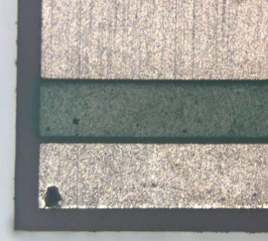
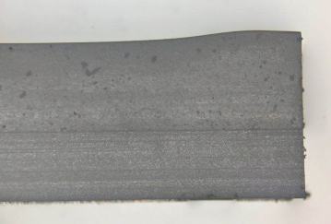
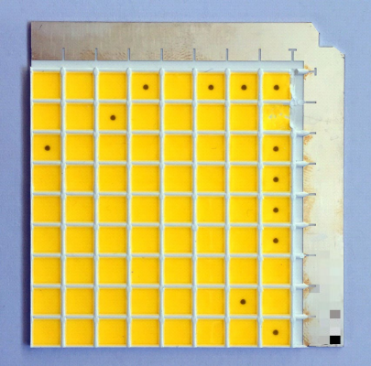
4.application case
HS25 series of the cutting and packaging case
-LED ceramic substrate case
 |  | LED LED Ceramic Substrate
Blade specification: HS25 56x3.0x0.12B 500S30S16
Substrate type: | Ceramic, LED beads | Substrate thickness: | 0.75mm coating layer+0.71mm substrate
LED size: | 5x5mm | main shaft speed ： | 25k rpm
feed velocity ： | 3mm/s
quality requirement ： | No chipping on the front and back, and no step on the side.

Slide 20
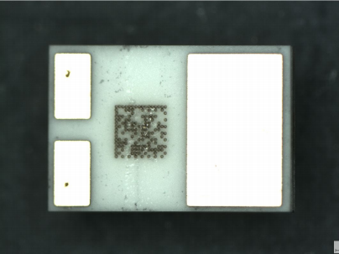
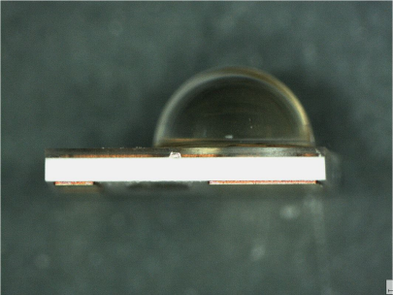
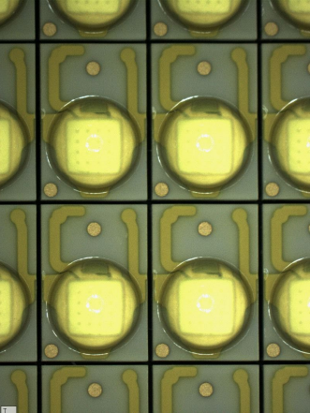
4.application case
HS25 series of the cutting and packaging case
-LED ceramic substrate case
Blade specification: HS25 5 8x3.0x0.16B 600S30S48
Quality requirements: No chipping on the front and back, no cracks or steps on the side. LED ceramic encapsulation substrate
Substrate type: | Ceramic, LED beads | Substrate thickness: | 0.5mm
LED size: | 3x5mm | main shaft speed ： | 45k rpm
feed velocity ： | 15mm/s

Slide 21
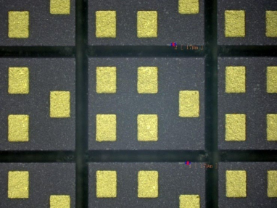
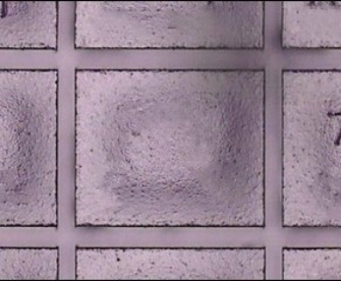
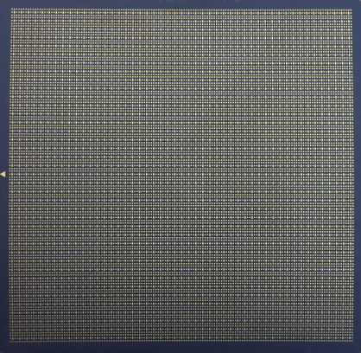
4.application case
Case of E25 series chip cutter for chip cutting and packaging
-Case of low-temperature ceramic and resin layer encapsulation and cutting
LTCC package
Blade specifications: | E25 58x0.15Bx40 600N50
Substrate type: | LTCC， filter | Substrate thickness: | 0.52mm
LED size: | 1.1x1.4mm | main shaft speed ： | 30k rpm
feed velocity ： | 60mm/s
quality requirement ： | The front side of the substrate has no chipping, and the back side has no burrs and flanges.

Slide 22


4.application case
Case of E25 series chip cutter for chip cutting and packaging
-PCB package cutting case
LED Display PCB Packaging Form
Blade specification: E25 56x0.08Ax40 800H70S16
Substrate type: | 1010PCB substrate, LED | Substrate thickness: | 140um
main shaft speed ： | 26krpm | feed velocity ： | 80mm/s
quality requirement ： | No metal burrs, no flanging, and no side threading or roughening.

Slide 23



4.application case
Case of E25 series chip cutter for chip cutting and packaging
-EMC package cutting case
 | LED chip EMC packaging substrate
Blade specification: E25 58x0.2Bx40 700S90
Substrate type: | EMC, LED beads | Substrate thickness: | 0.38mm
LED size: | 4x4mm | main shaft speed ： | 30k rpm
feed velocity ： | 55mm/s
quality requirement ： | The front of the substrate has no chipping, and the back has no burrs or flanges.

Slide 24






5.service commitment
pay
Orders of 500 pieces or fewer will be delivered within 7 working days.
develop
sample
Assist customers in blade selection and new cutting process development; exchange Technical exchange and regular follow-up visits | Provide free test samples; feedback Report quality issues in an 8D report
respond
8 hours for rapid service response, 48 hours for on-site arrival;

Slide 25
contact way
Jiangsu Henglihong Technology Co., Ltd.
Jiangsu Henglihong Technology Co., Ltd.
Company Address: No.6 Xinrong Road, Xinwu District, Wuxi City, Jiangsu Province
Mailbox: jzdz@jzdz-wx.com
Website: www.jeez-semicon.com

